Slide 1

Function generator
SELF PROJECT
Aya Mohamed Sayed
Sec 1
B.No 9
Shubra faculty of engineering
Dr.Tarek Elewa

Slide 2

OUR TOPICS
Define what is function generator
The role of Function generator
Our circuit
Explain the circuit
Components
The breadboard of circuit
Function generator

Slide 3
WHAT IS FUNCTION GENERATOR
Definition: Function Generator is basically a signal generator that produces different types of waveforms at the output. It has the ability to produce waveforms such as sine wave, square wave, a triangular wave, sawtooth wave etc. An adjustable frequency range is provided by the function generator which is in the range of some Hz to several 100KHz
Function generator

Slide 4
THE ROLE OF FUNCTION GENERATOR
A function generator is a electronic device that can produce a variety of different waveforms. The one we will build can output square, triangle, or sine waveforms. Like standard function generators.
Function generator

Slide 5
OUR CIRCUIT WITH LM324
Our Components
IC555
1 560Ω resistors
1KΩ resistors
10KΩ resistors, 62KΩ resistor
0.1μF ,0.01μF, 10μF , 0.47μF and 100μF ceramic capacitor
20KΩ potentiometer
Function generator

Slide 6
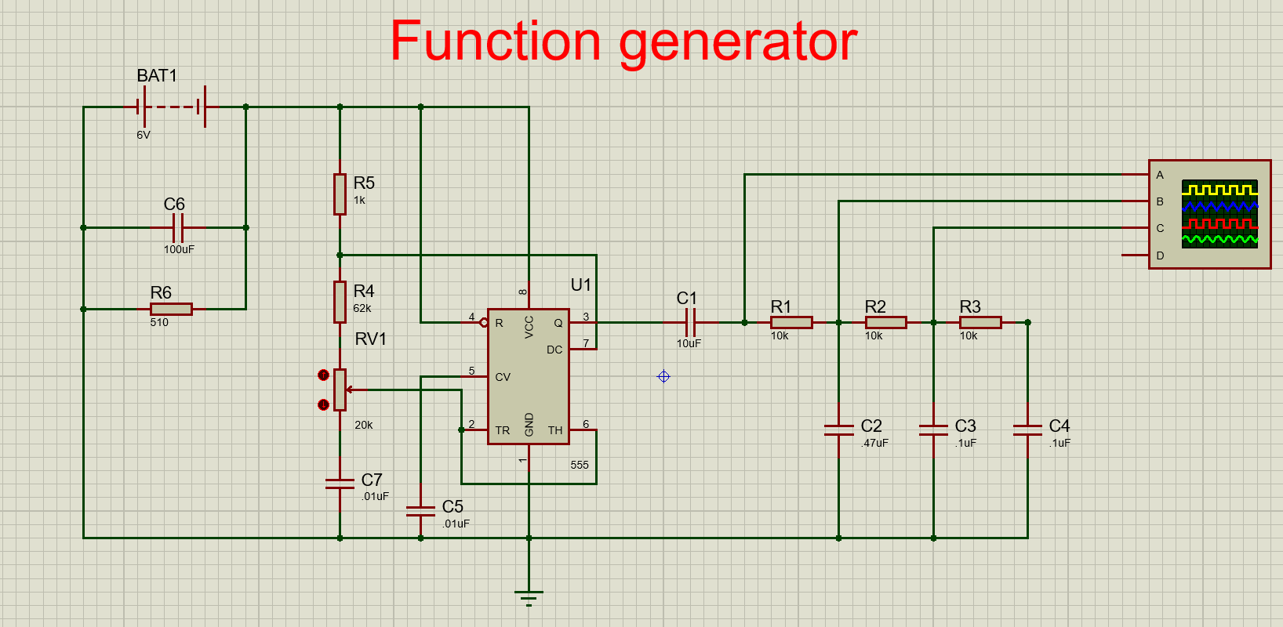
FUNCTION GENERATOR CIRCUIT BUILT WITH AN IC555 CHIP
The function generator circuit we will build with an IC555 op amp chip is shown below
Function generator

Slide 7
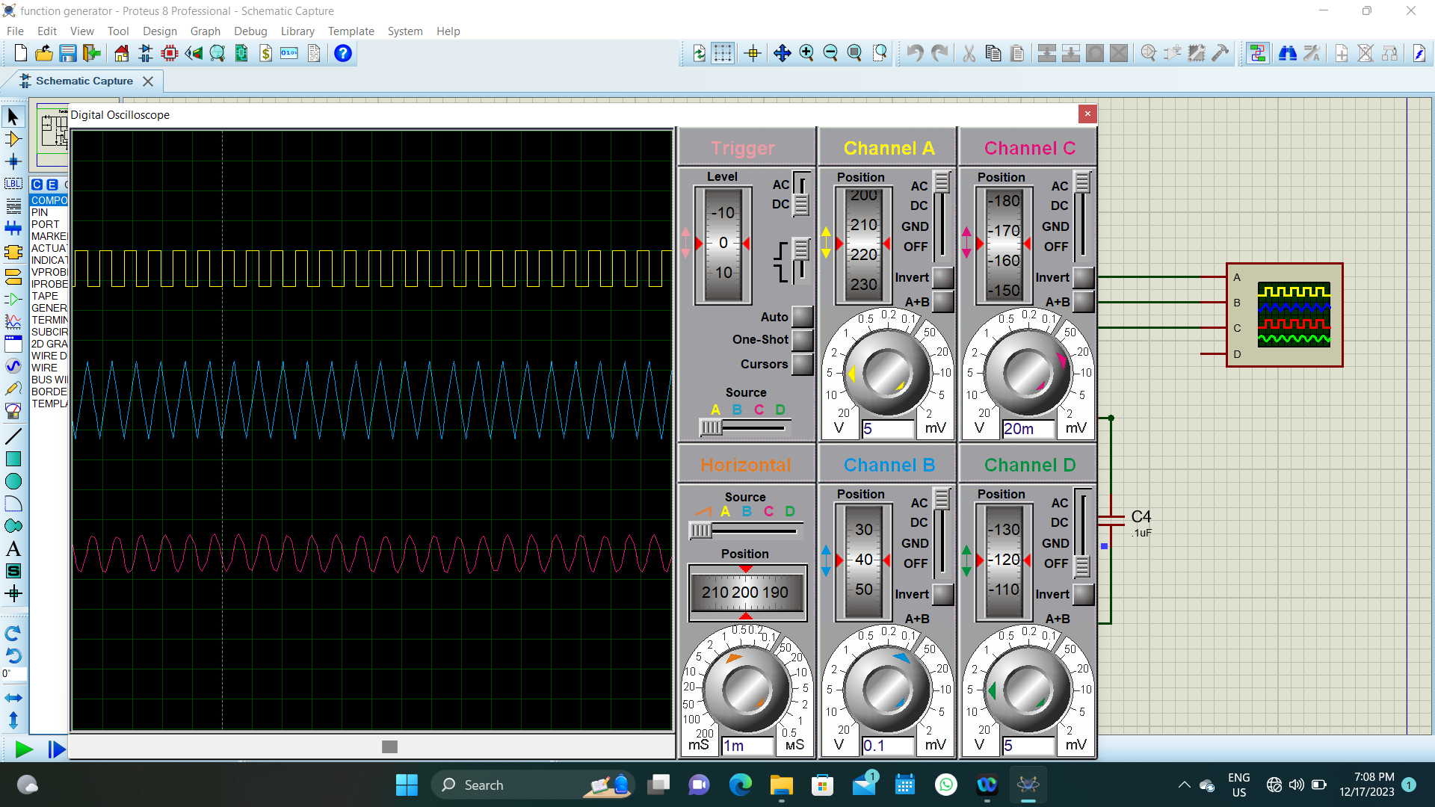
FUNCTION GENERATOR CIRCUIT BUILT WITH AN IC555 CHIP
The function generator circuit we will build with an IC555 op amp chip is shown below
Function generator

Slide 8
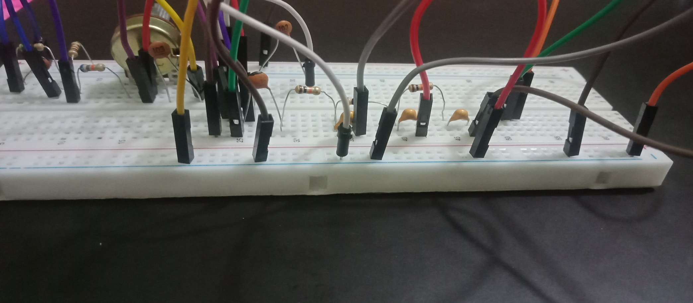
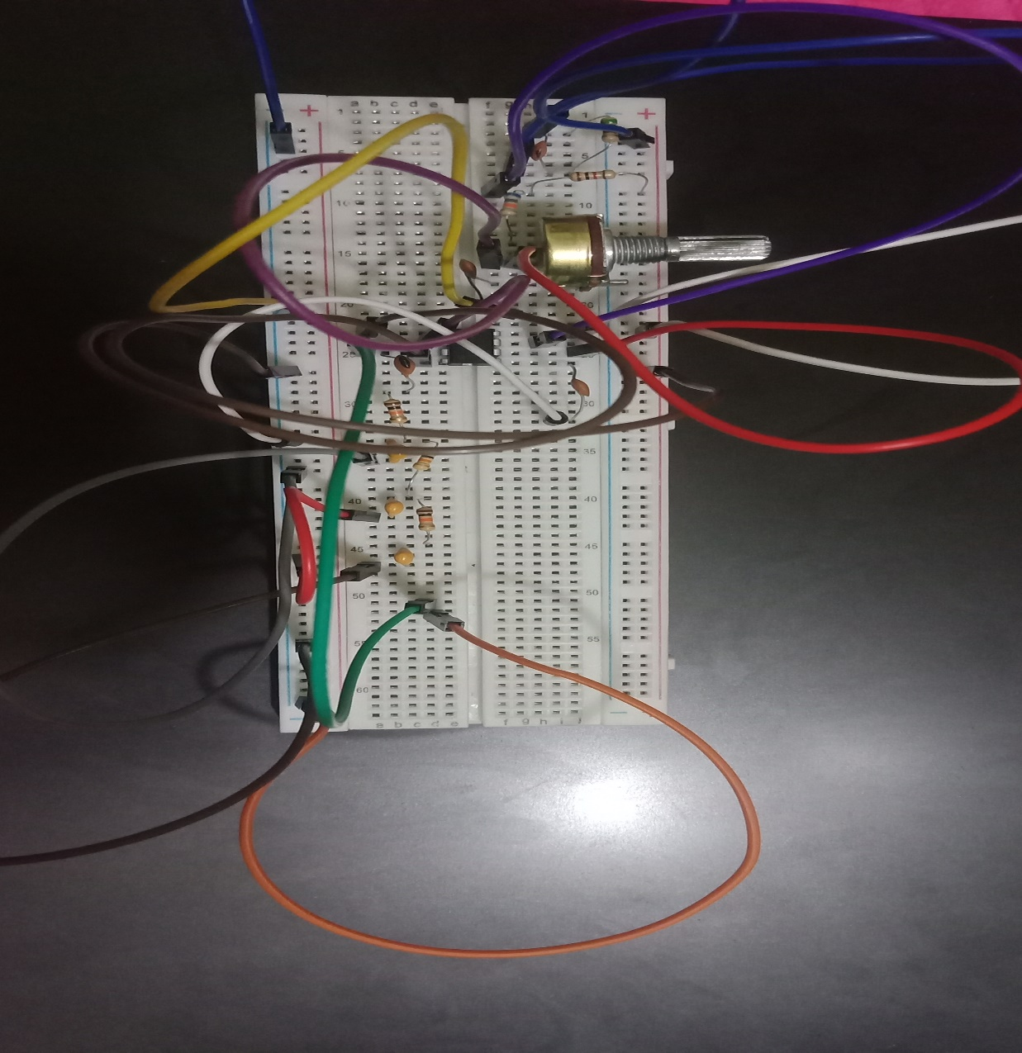
FUNCTION GENERATOR CIRCUIT BUILT WITH AN IC555,THE BREADBOARD
The function generator circuit we will build with an IC555 is shown below
Function generator

